Slide 1


Laura Roberts
23 Nov 2024
https://github.com/laurahc55/dataScienceCapstone/tree/main

Slide 2

Outline
Executive Summary
Introduction
Methodology
Results
Conclusion
Appendix

Slide 3
Executive Summary
The data was collected from SpaceX REST API and the Wiki pages about the Falcon 9 launches. We analyze 90 landings in total with 60 successful landings and 30 unsuccessful ones.
Visualization to see the relationships between the different variables were created and some interesting questions were answered by summarizing some of the data using SQL. Maps of the launch sites are included with the number of launches from each site and the outcome, to quickly see the performance of each launch site.
A Decision Tree with an 89% of accuracy on the test data was the best model to predict the outcome of a landing mission. Using this model, we will predict if the Falcon 9 stage will land successfully and determine the cost of a launch to be able to bid against SpaceX for a rocket launch.

Slide 4
Introduction
SpaceX advertises Falcon 9 rocket cost on its website, much of the savings is because SpaceX can reuse the first stage. Therefore, if we can determine if the first stage will land, we can determine the cost of a launch. We will use this information to bid against SpaceX for a rocket launch.
Notes:
Our goal is to determine the price of each launch. We will do this by gathering information about Space X and creating dashboards. We will also determine if SpaceX will reuse the first stage. We trained a machine learning model and use public information to predict if SpaceX will reuse the first stage.
Our goal is to use this data to predict whether SpaceX will attempt to land a rocket or not.

Slide 5

Section 1

Slide 6
Methodology
Executive Summary
Collected data from SpaceX REST API to analyze the Falcon 9 launches and information from the Wiki pages about the Falcon 9 launches was gathered using web scrapping techniques. We included launches from before13th Nov 2020 and with a single core and payload. Missing payloadMass values were replaced by the mean. We analyze 90 landings in total with 60 successful landings and 30 unsuccessful ones.
Visualization of the variables to be included in the model were created to understand the relationships between the different variables and some questions were answered by analyzing the data using SQL. The launch sites were included in a map with the number of launches from each site and the outcome to quickly see where the launches happened and the success rate of each site.
The models trained to predict the outcome of a landing were: Logistic regression, Support Vector Machine, Decision Tree and K Nearest Neighbor clustering. We trained thousands of models to find the best parameters for each models and then tested the accuracy using data that those models on the testing data.

Slide 7
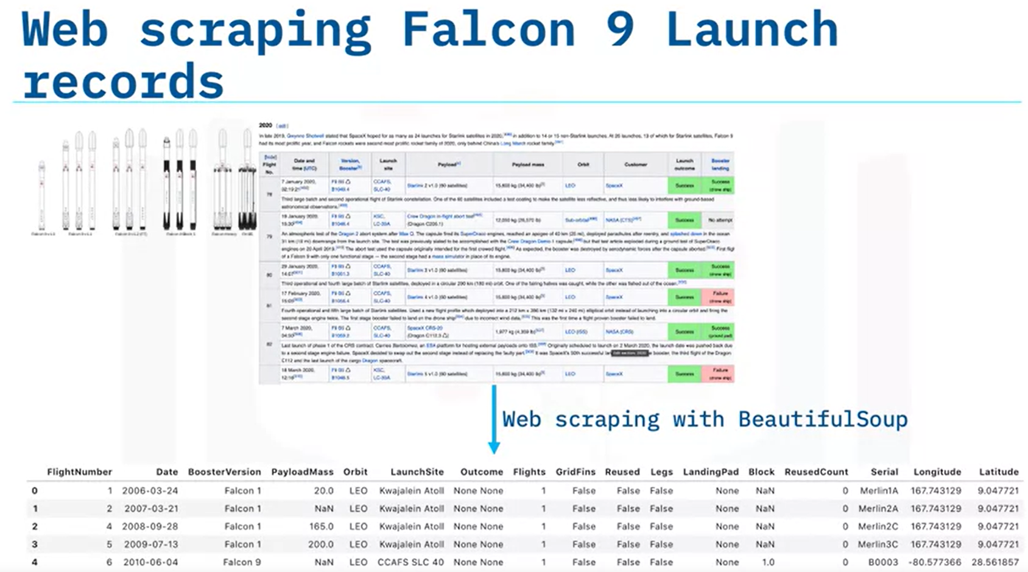
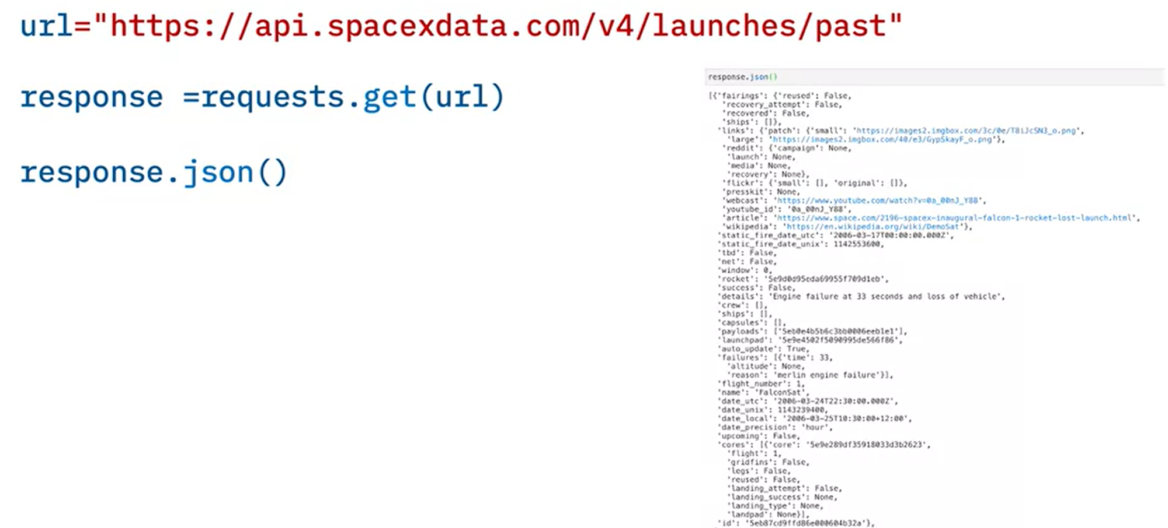
Data Collection
Launch data from the SpaceX REST API, which contains:
rocket used
payload delivered
launch specifications
landing specifications
landing outcome
Wiki pages about the Falcon 9 launches
Notes:
Collecting the Data with an API. In this capstone assignment, we will be working with SpaceX launch data that is gathered from an API, specifically the SpaceX REST API. This API will give us data about launches, including information about the rocket used, payload delivered, launch specifications, landing specifications, and landing outcome.
The SpaceX REST API endpoints, or URL, starts with api.spacexdata.com/v4/.
We have the different end points, for example:
/capsules
and /cores
We will be working with the endpoint api.spacexdata.com/v4/launches/past.
Let’s see how the API works.
We will use this URL to target a specific endpoint of the API to get past launch data.
We will perform a get request using the requests library to obtain the launch data, which we
will use to get the data from the API.
This result can be viewed by calling the .json() method.
Our response will be in the form of a JSON, specifically a list of JSON objects.
Since we are using an API, you will notice in the lab that when we get a response it
is in the form of a JSON.
Specifically, we have a list of JSON objects which each represent a launch.
To convert this JSON to a dataframe, we can use the json_normalize function.
This function will allow us to “normalize” the structured json data into a flat table.
This is what your JSON will look like in a table form.
Another popular data source for obtaining Falcon 9 Launch data is web scraping related
Wiki pages.
In this lesson, you will be using the Python BeautifulSoup package to web scrape some HTML
tables that contain valuable Falcon 9 launch records.
Then you need to parse the data from those tables and convert them into a Pandas data
frame for further visualization and analysis.
We want to transform this raw data into a clean dataset which provides meaningful data
on the situation we are trying to address:
Wrangling Data using an API,
Sampling Data, and
Dealing with Nulls.
You will notice, in some of the columns, like rocket, we have an identification number,
not actual data.
This means we will need to use the API again targeting another endpoint to gather specific
data for each ID number.
These functions are already created for you, and will use the following:
Booster,
Launchpad,
payload, and
core.
The data will be stored in lists and will be used to create our dataset.
Another issue we have is that the launch data we have includes data for the Falcon 1 booster
whereas we only want falcon 9.
In this lab, you will need to figure out how to filter/sample the data to remove Falcon
1 launches.
Finally, not all gathered data is perfect.
We may end up with data that contains NULL values.
We must sometimes deal with these null values in order to make the dataset viable for analysis.
In this case, we will deal with the NULL values inside the PayloadMass.
In this lab, you must figure out a way to calculate the mean of the PayloadMass data
and then replace the null values in PayloadMass with the mean.
We will leave the column LandingPad with NULL values, as it is represented when a landing
pad is not used.
This will be dealt with using one hot encoding later on.

Slide 8
Data Collection – SpaceX API
Set up
Import required libraries
Define functions to collect the data
Import data
Request rocket launch data from SpaceX API
Convert the Json result into a dataframe
Clean data
Only keep the colunms: rocket, payloads, launchpad, cores, flight numbers and date
Only include Falcon 9 launches
Filter data
Remove rows with multiple cores because those are falcon rockets with 2 extra rocket boosters and rows that have multiple payloads in a single rocket
Extract single value of payloads and cores
Convert the date_utc to a datetime and restrict the dates of the launches to be before Nov 13, 2020
Reset the flight number column to only account for selected rows
Handle missing values
Input the mean PayloadMass into the rows with missing values in the PayloadMass column
https://github.com/laurahc55/dataScienceCapstone/blob/main/1-Spacex-Data_collection_API.ipynb
Notes:
https://github.com/laurahc55/dataScienceCapstone/blob/main/1-Spacex-Data_collection_API.ipynb

Slide 9
Data Collection - Scraping
Set up
Import required libraries
Define functions to process web scraped HTML table
Import data
Scrape the data from a snapshot of the Wikipage updated on 9th June 2021
Extract data
Find column/variable names from the HTML table header
Create a data frame by parsing the launch HTML tables
Perform an HTTP GET method to request the Falcon9 Launch HTML page
Create a object from the HTML
Create a BeautifulSoup object from a response text content
https://github.com/laurahc55/dataScienceCapstone/blob/main/2-Webscraping.ipynb
Notes:
https://github.com/laurahc55/dataScienceCapstone/blob/main/3-Webscraping.ipynb

Slide 10
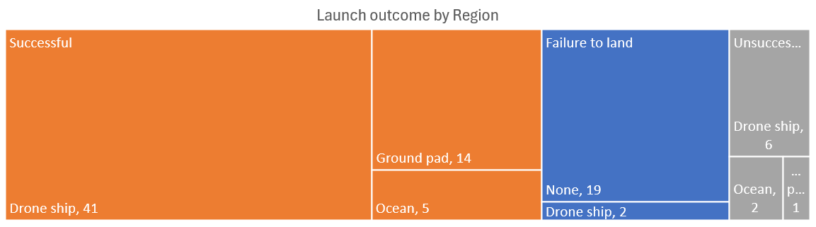
Data Wrangling
https://github.com/laurahc55/dataScienceCapstone/blob/main/3-Spacex-Data_wrangling.ipynb
Notes:
https://github.com/laurahc55/dataScienceCapstone/blob/main/3-Spacex-Data_wrangling.ipynb

Slide 11
EDA with Data Visualization
We created various charts to quickly understand the success rate by, payload mass, orbit, launch site and year and noticed some patterns that might be able to help predict the outcome of a mission. These graphs showed some interesting findings that were highlighted in those specific sections.
https://github.com/laurahc55/dataScienceCapstone/blob/main/4-Exploratory_data_analysis-Data_visualization.ipynb
Notes:
https://github.com/laurahc55/dataScienceCapstone/blob/main/4-Explorator_data_analysis-Data_visualization.ipynb

Slide 12
EDA with SQL, we found:
The names of the unique launch sites in the space mission
5 records from launch sites that begin with the string 'CCA’
The total payload mass carried by boosters launched by NASA (CRS)
The average payload mass carried by booster version F9 v1.1
The date when the first successful landing outcome in ground pad was achieved
The boosters that have successfully landed a rocket with a payload mass between 4000 and 6000 in a drone ship
The total number of successful and failure mission outcomes
The booster versions which have carried rockets with the maximum payload mass
The month, booster versions and, launch site of the missions that fail to land in a drone ship in 2015
The frequency of each lading outcome from 2010-06-04 and 2017-03-20, listing the most frequent first
https://github.com/laurahc55/dataScienceCapstone/blob/main/5-Exploratory_data_analysis-with_SQLeda-sql-coursera_sqllite.ipynb

Slide 13
Interactive Map with Folium
Maps with the location of each launch site, the number of launches from each site and the outcome of the mission represented by the color (green meaning successful and red meaning unsuccessful). Lines from each launch site to the closest city, railroad, highway and coastline including the distance in km.
https://github.com/laurahc55/dataScienceCapstone/blob/main/6-Visual_Analytics_with_Folium.ipynb

Slide 14
Dashboard with Plotly Dash
A dashboard was created to visualize and compare the successful launches from all the launch sites and the proportion of successful launches vs unsuccessful launches for each site.
We also created a dynamic graph that allows us to see the relationship between payload and the outcome of the mission and what booster version was used for each one. Including a slider to select the range of the payload mass we want to see, and we can also filter by launch site.
https://github.com/laurahc55/dataScienceCapstone/blob/main/7-Dashboard.py

Slide 15
Predictive Analysis (Classification)
First, we divided our data into 72 observations for training and 18 observation for testing our results.
We trained and selected the best model for each technique out of:
30 Logistic Regression
1,250 Support Vector Machine
3,240 Decision Trees
800 KNN clustering
To evaluate the accuracy of the four best models we used our test data set and selected the model with the highest accuracy on the test data.
https://github.com/laurahc55/dataScienceCapstone/blob/main/8-SpaceX_Machine_Learning_Prediction.ipynb

Slide 16
Results
The selected model was a decision tree with an 89% accuracy, correctly predicting the landing outcome of 16 out of the 18 test cases.
The variables used in the model are:
Payload Mass, Orbit, Flights, Blocks, Reused, Legs, Grid fins, Booster type, Launch Site, Serial and , Landing Pad
The success rate of the last 70 is more than 3 times higher than the success rate of the first 20 launches. Which also means the success rate of a mission has been much higher in the recent years.
The success rate to the orbit VLEO (86%) is the highest of the three orbits with the most frequent launches.

Slide 17

Section 2

Slide 18
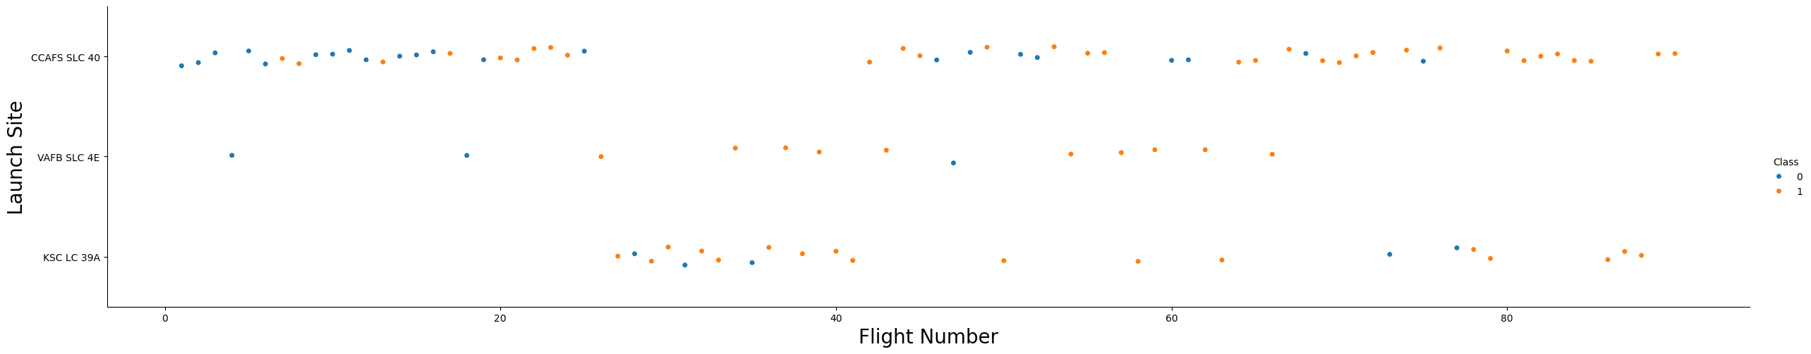
Flight Number vs. Launch Site
The success rate for the first 20 launches was only 25% compared to 80% for the last 70 launches
The CCAFS SLC 40 station has the lowest success rate at about 60% and like the previous finding the success rate of the first 18 missions from this site only 28% compared to a 76% success rate on the last 37 missions

Slide 19
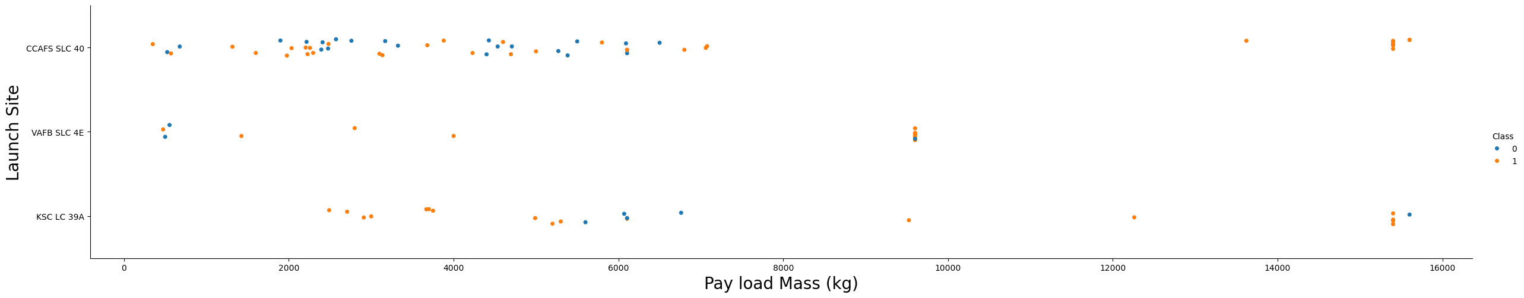
Payload vs. Launch Site
The heavier (>8k kg) payloads have a higher success rate of 87% than the medium (4k-8k kg) with only 50%.
The launch station KSC LC 39A have 4 out of 5 unsuccessful launches from rockets with medium payload mass
The launch station VAFB SLC 4E have only launched light (<=4k kg) and heavy rockets (>8k kg)

Slide 20
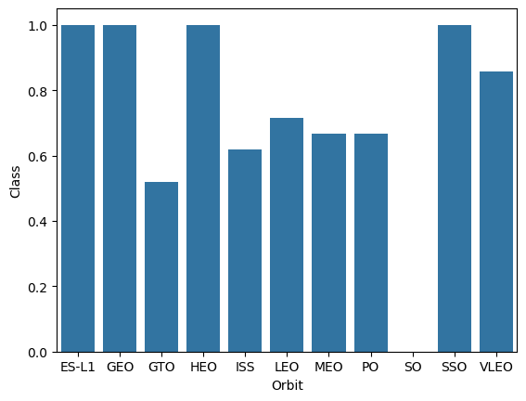
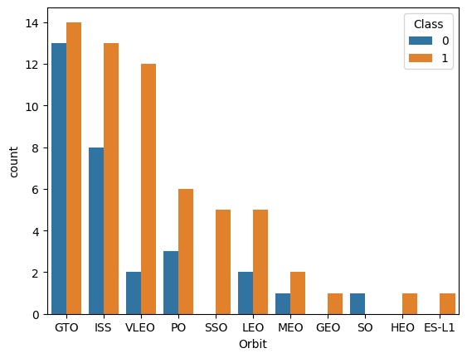
Success Rate vs. Orbit Type
Of the three launch stations that account for ~70% (62) of the launches, VLEO has the highest success rate of 86% followed by ISS with 62% and GTO has the lowest with 52%
All the launch to ES-L1 (1), GEO (1), HEO (1) and SSO (5) have being successful but those only account for ~9%. launches
The only launch to the SO was unsuccessful

Slide 21
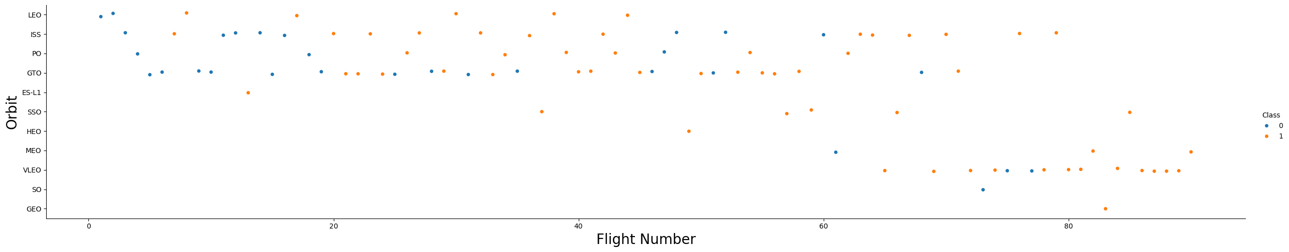
Flight Number vs. Orbit
There hasn’t been a launch to the LEO orbit since the 44th flight
The last 6 launches to the ISS orbit have been successful
The launches to the GTO orbit went from 25 out of the first 60 (~40%) to only 2 out of the last 30 (~7%)
Almost half of the last 30 launches were to the VLEO orbit

Slide 22
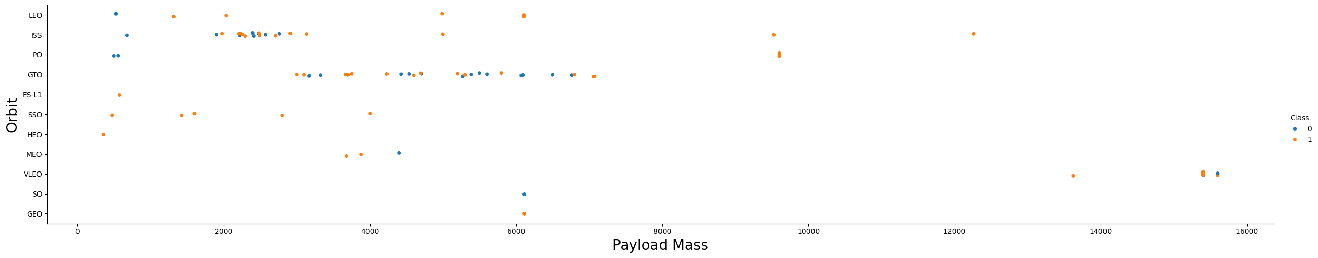
Payload vs. Orbit Type
ISS orbit: Most (~60%) of the unsuccessful launches of the rockets with light payload mass (4k kg) were to this orbit
GTO orbit: ~80% of the unsuccessful launches of the rockets with medium payload mass (4-8k kg) were to this orbit vs only ~15% of the unsuccessful launches of the rockets with light payload mass (4k kg)
VLEO orbit: all the rockets launch to this orbit have the heaviest payload mass (>8k kg) and the success rate of ~85%

Slide 23
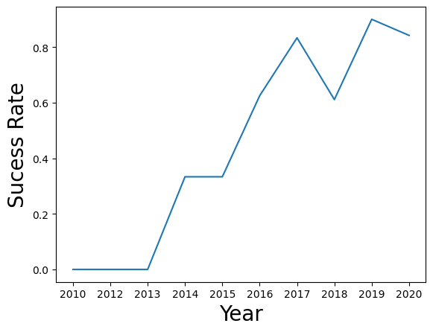
Launch Success Yearly Trend
The success rate since 2017 have being >60%
In 2019 we saw the highest success rate of 90%
~72% of launches happened from 2017 to 2020

Slide 24
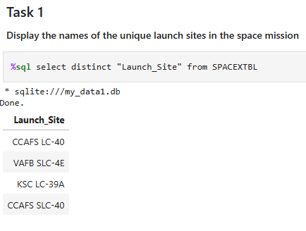
All Launch Site Names
The four launch sites for the Falcon 9 missions are:
CCAFS LC 40
VAFB SLC 4E
KSC LC 39A
CCAFS SLC 40

Slide 25
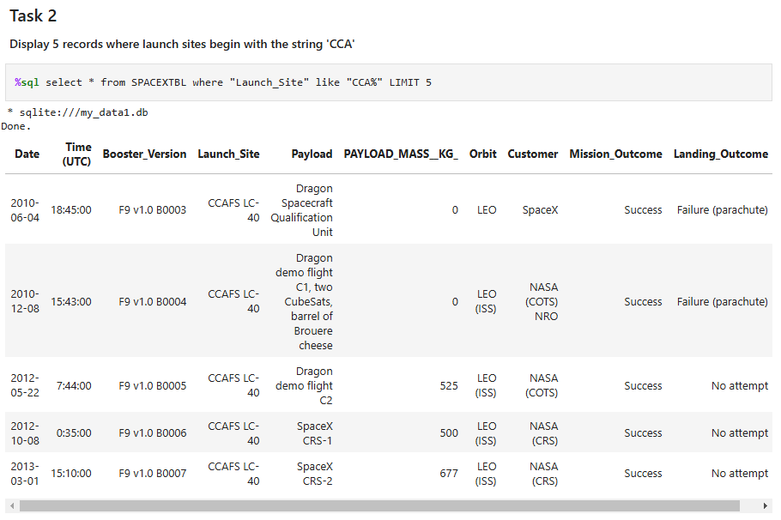
Launch Site Names Begin with 'CCA'
Here is a sample of some of the launches made from sites the begin with CCA
Sites like:
CCAFS LC 40
CCAFS SLC 40

Slide 26
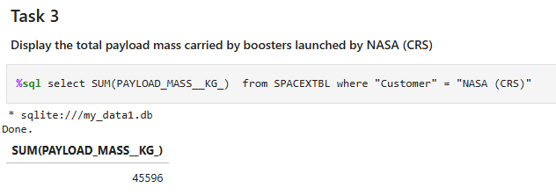
Total Payload Mass
NASA (CRS) has launched a total of 45,596 kg of payload mass.

Slide 27
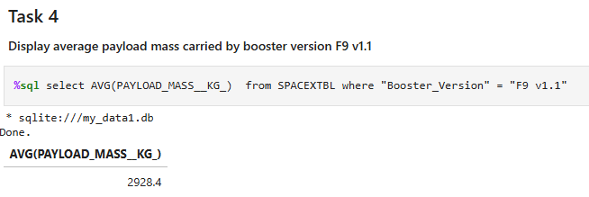
Average Payload Mass by F9 v1.1
The booster version F9 v1.1 carries 2,928.4 kg of payload mass on average.

Slide 28
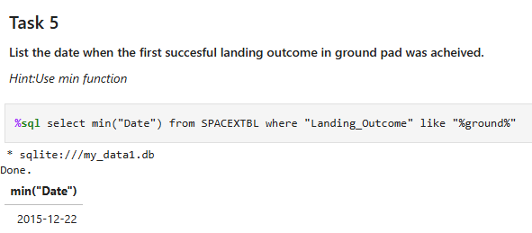
First Successful Ground Landing Date
The first successful ground landing was on the 22nd of December 2015

Slide 29
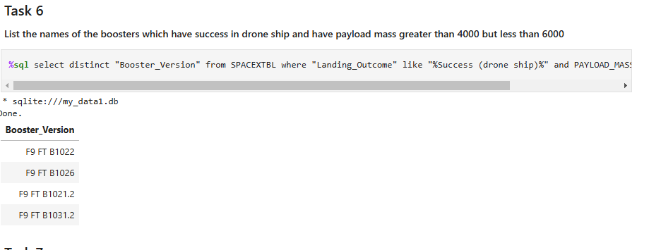
Successful Drone Ship Landing with Payload between 4000 and 6000
The booster version that have successful landed drone ship landing with a payload between 4k-6k are:
F9 FT B1022
F9 FT B1026
F9 FT B1021.2
F9 FT B1031.2

Slide 30
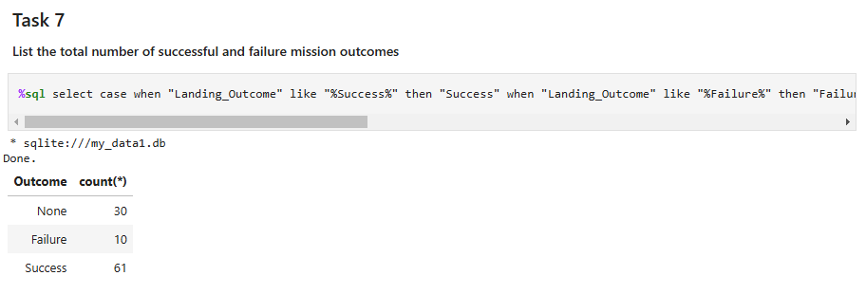
Total Number of Successful and Failure Mission Outcomes
61 of the 101 missions had a successful outcome
30 of the 101 missions did not land
10 of the 101 missions had an unsuccessful outcome

Slide 31
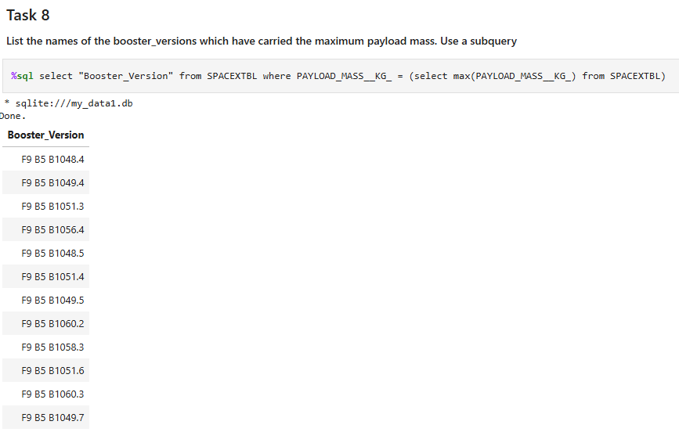
Boosters Carried Maximum Payload
The booster version that have carried the maximum payload mass are:
F9 B5 B1048.4
F9 B5 B1049.4
F9 B5 B1051.3
F9 B5 B1056.4
F9 B5 B1048.5
F9 B5 B1051.4
F9 B5 B1049.5
F9 B5 B1060.2
F9 B5 B1058.3
F9 B5 B1051.6
F9 B5 B1060.3
F9 B5 B1049.7

Slide 32
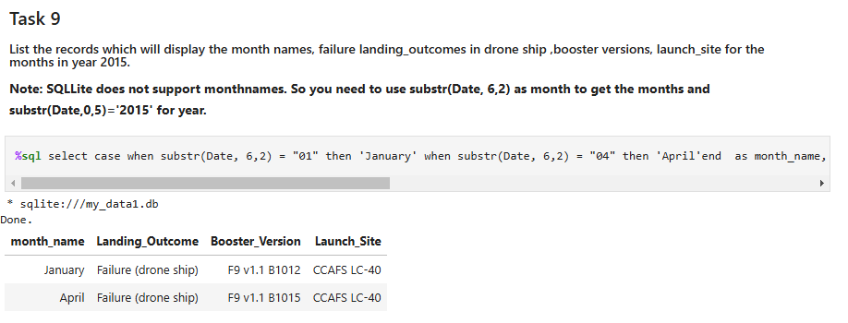
2015 Launch Records
In 2015 there were two launches, both failed to land on a drone ship to the CCAFS LC-40 launch site; one in January, booster version F9 v1.1 B1012 and one in April, booster version F9 v1.1 B1015.

Slide 33
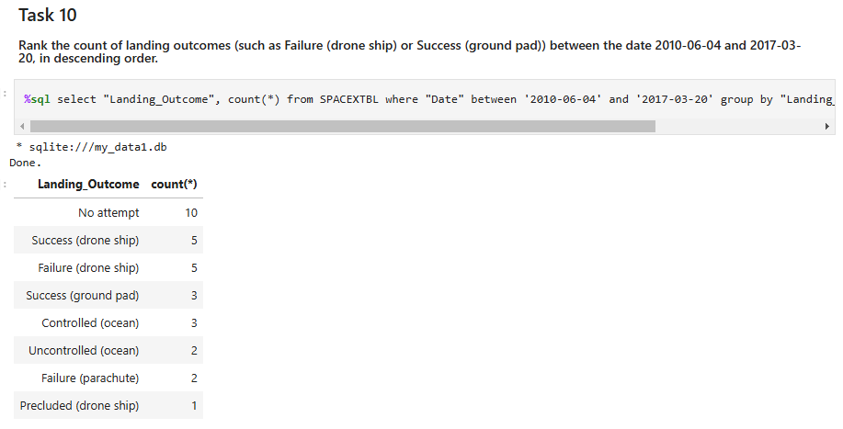
Rank Landing Outcomes Between 2010-06-04 and 2017-03-20
Half of the rockets from Jun 4th,2010 to Mar 20th ,2017 did not attempt a landing

Slide 34

Section 3

Slide 35
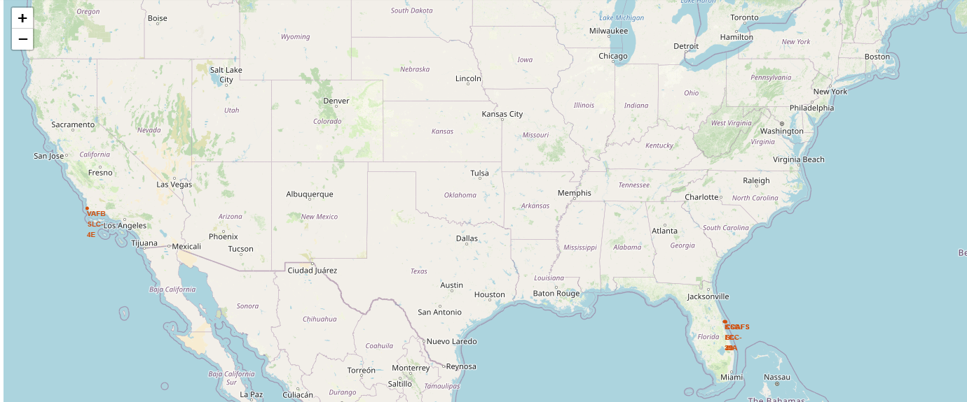
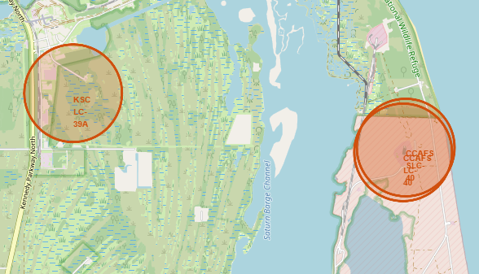
Launch site location
Only one of the four launch sites is in California, the rest of the launch sites are in Florida. With the CCAFS launch sites being within a mile from each other

Slide 36
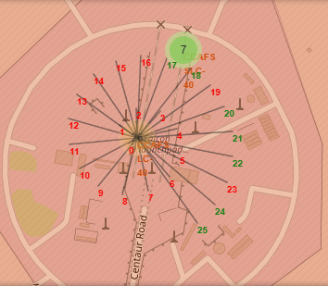
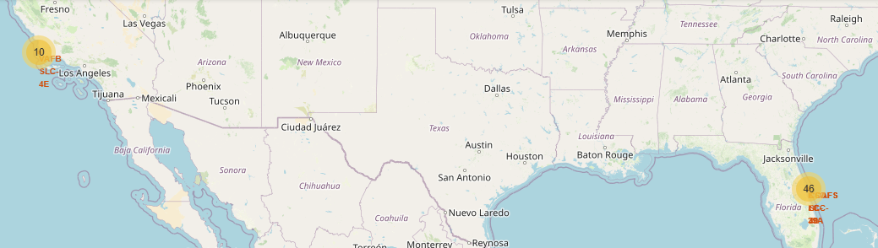
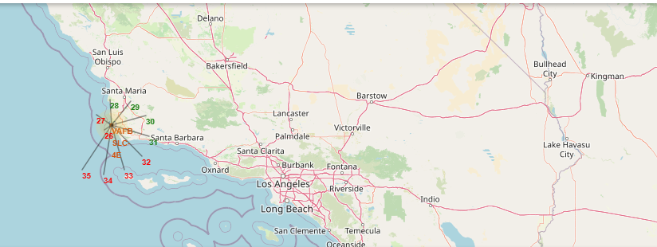
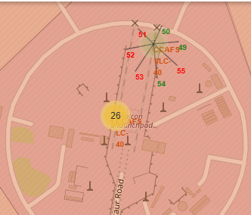
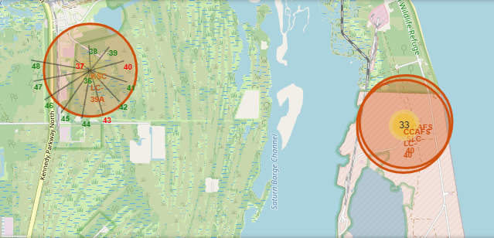
Outcome of the launch per landing site
CCAFS SLC-40
VAFB SLC-4E
CCAFS LC-40
KSC LC-39A

Slide 37
Outcome of the launch per landing site
KSC LC-39A has the highest proportion of successful landings
CCAFS LC-40 only have 7 landings with only 3 successful ones
4 out of the 10 landings in the landing site VAFB SLC-4E were successful
CCAFS SLC-40 is the landing site with the most landing but only 7 have being successful
CCAFS SLC-40
VAFB SLC-4E
CCAFS LC-40
KSC LC-39A

Slide 38
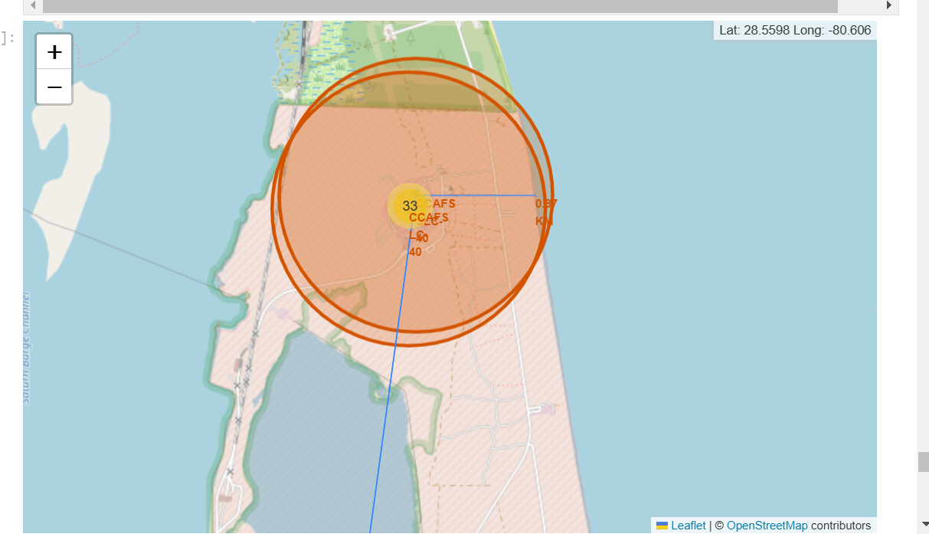
Launch site proximities to railway, highway and, coastline
Launch sites tend to be close to a railway, highway and the coastline but not too close to cities

Slide 39

Section 4

Slide 40
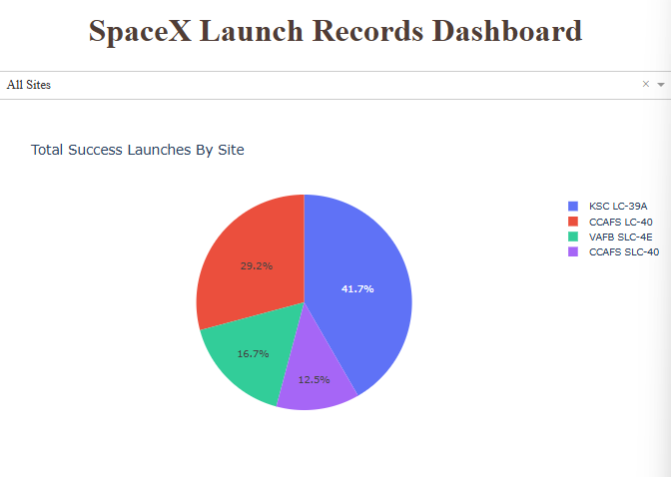
Launch success count for all sites
41.7% of the successful launches are from the launch site KSC LC-39A
29.2% of the successful launches are from the launch site CCAFS LC-40

Slide 41
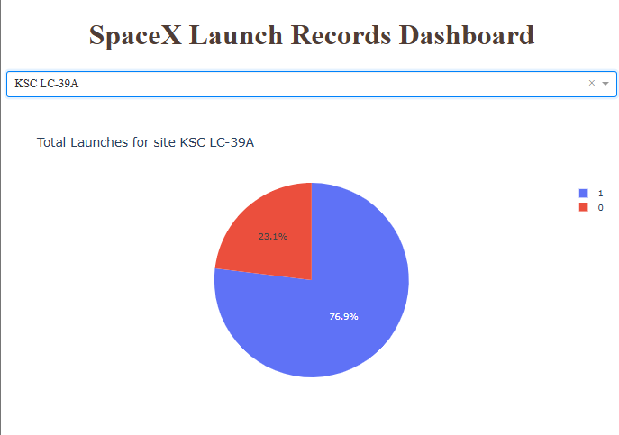
Launch site with highest launch success ratio
The launch site KSC LC-39A has the highest launch success ratio with 76.9% of launches being successful

Slide 42
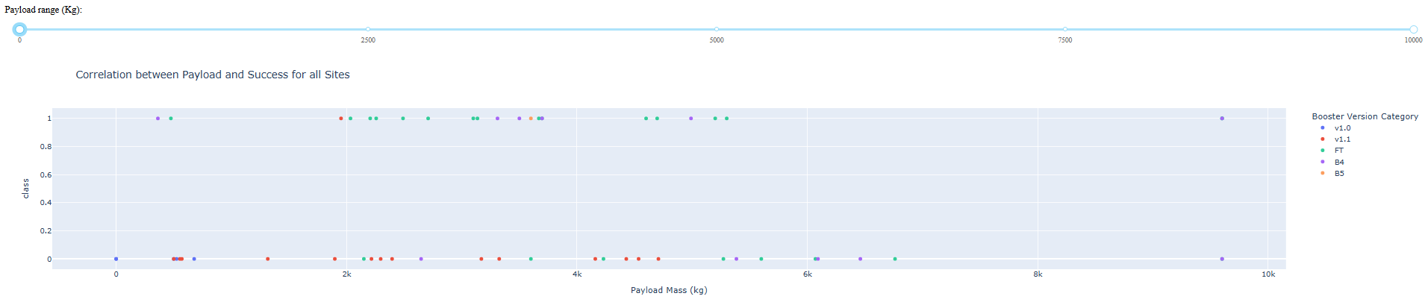
Payload vs. Launch Outcome scatter plot for all sites, with different payload selected in the range slider
Most launches have a payload mass of 2k-6k kg.
The category booster version of most of the rockets with the heaviest payload is B4
The rockets with the booster version category v1.1 tend to have an unsuccessful mission outcome

Slide 43

Section 5

Slide 44
Classification Accuracy
The model with the highest accuracy was the decision tree with an accuracy of 89%

Slide 45
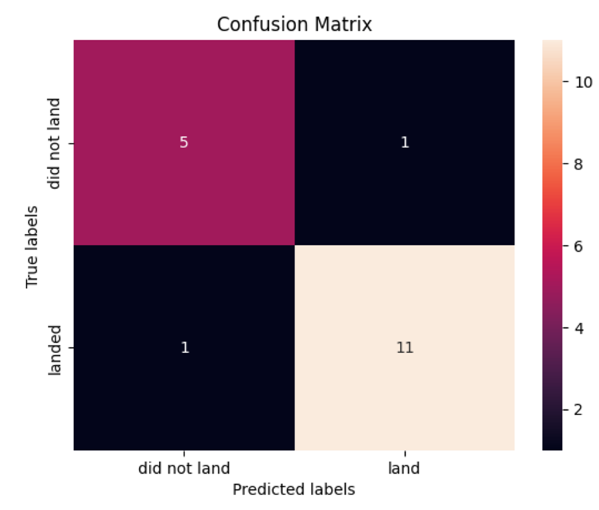
Confusion Matrix
The decision tree correctly classify 16 out of the 18 test cases

Slide 46
Conclusions
We can predict with high accuracy the landing outcome of the different launches which we can in turn use for predict the cost of the next launch
The variables that impact the landing outcome of a launch are:
Payload Mass, Orbit, Flights, Blocks, Reused, Legs, Grid fins, Booster type, Launch Site, Serial and , Landing Pad
Most of the landings in the year 2017-2020 were successful
The rockets with the heaviest payload mass tend to have more successful landings

Slide 47


